Slide 1
How to process Flat Files documents (TXT, CSV …) in BizTalk Server
XI Porto.Data Community Metting
Sandro Pereira
Senior Software Developer
Microsoft Integration MVP

Slide 2






Hello Porto.Data, good night!
Sandro Pereira
Senior Software Developer | Microsoft Integration MVP
sandro.pereira@devscope.net
linkedin.com/in/sandropereira
@sandro_asp
sandroaspbiztalkblog.wordpress.com
+351 223 751 350
www.devscope.net

Slide 3

FLAT
FILES...
REALLY?!?

Slide 4
Agenda
Short Introduction to BizTalk Schemas
Creating Flat File Schemas
Basic Flat Files Annotations
DEMOS
How we can easily implement a robust File Transfer integration in BizTalk Server
using Content-Based Routing in BizTalk with retries, backup channel and so on
How to process Flat Files documents (TXT, CSV …) in BizTalk Server.

Slide 5

Short Introduction to BizTalk Schemas

Slide 6
Reviewing XML Terminology
XML Standards:
Elements
Attributes
Namespaces in XML
XML Schema (XSD)
XML Path Language (XPath)
Extensible Stylesheet Language Transformations (XSLT)
Document Object Model (DOM)
SOAP
Web Services Description Language (WSDL)

Slide 7
What Are XML Namespaces?
Namespaces:
Provide unique names for elements and attributes
Prevent naming conflicts with other schemas
Use the xmlns attribute to declare the namespace the element belongs to
A prefix is added to the declaration to remove ambiguity
<salesReport xmlns="http://adventure-works.com/salesReport" xmlns:prod="http://adventure-works.com/products">
<customer id="Fabrikam">
<sales>
<prod:id>widget1004</prod:id>
<prod:unitsSold>100</prod:unitsSold>
<prod:price prod:currency="USD">35</prod:price>
</sales>
</customer>
</salesReport>

Slide 8


How Does BizTalk Use XML Namespaces?
BizTalk Server
Message A TargetNamespace= “NewOrders”
Record
Schema A TargetNamespace= “NewOrders”
PO
Status
ItemID
Qty
UnitPrice
Date
Message B TargetNamespace= “OrderUpdate”
Header
Field1
PO
Schema B TargetNamespace= “OrdersUpdate”
Field2
Status
Field3
Item
Field1
Field2
Field3
Message C TargetNamespace= “Inventory”
No Match

Slide 9
What Is a BizTalk XML Schema?
<xs:schema targetNamespace="http://contoso.com/invoice" xmlns:xs=“http://www.w3.org/2001/XMLSchema” attributeFormDefault="unqualified“ elementFormDefault="qualified">
<xs:element name="Item">
<xs:complexType>
<xs:sequence>
<xs:element name="Description" type="xs:string" />
<xs:element name="Quantity" type="xs:integer" />
<xs:element name="UnitPrice" type="xs:decimal" />
<xs:element name="ItemID" type="xs:string" /> </xs:sequence>
</xs:complexType>
</xs:element>
</xs:schema>
<!-- XML Instance -->
<Item xmlns="http://contoso.com/invoice">
<Description>Widget</Description>
<Quantity>10</Quantity>
<UnitPrice>1.04</UnitPrice>
<ItemID>A1234</ItemID>
</Item>
BizTalk uses the XML schema definition language (XSD)

Slide 10
Supported BizTalk Schema Types
Edition | Description
XML | Supports native XML message types Defined in XML Schema definition language (XSD)
Flat File | Supports delimited or positional file formats XML tags used to represent values Tag information stored using the annotation capabilities of XSD
EDI | Specially formatted text message BizTalk supports EDIFACT and X12 formats XSD annotations used to define format
JSON | Supports JSON messages Before the application can process the message, it must be converted to an XSD schema - JSON to XML Converter for use with the WFX Schema Generation tool
Header
Field1
PO
Field2
Status
Field3
Item
Field1
Node
Structure
Start
Length
Description
Delimited
0
50
UnitPrice
Delimited
50
10
Quantity
Delimited
60
10
ISA:00: :00: :01:1515151515 :01:515151 :041201:1217:U:00403:000032123:0:P:*~GS:CT:99887766 55:1122334455:20041201:1217:128:X:004030~ST:831:00128001~BGN :00:88200001:20041201~N9:BT:88200001~TRN:1:88200001~AMT:2:10
{
"id": 1, "name": "A green door",
"price": 12.50,
"tags": ["home", "green"]
}

Slide 11
Flat File Structures
Delimited flat files
Fields separated by a specified delimiter
Have a common end-of-record terminator
John, Smith, 123 Main St., “Learning BizTalk Server 2010”
Positional flat files
Fields are fixed length
Have a common end-of-record terminator
John Smith 123 Main St. Learning BizTalk Server 2010

Slide 12
How can we create schemas?
Schema creation methods:
Create from scratch using BizTalk Editor
Import or include existing types
Generate from an instance message
Migrate an older XDR schema to an XSD schema

Slide 13
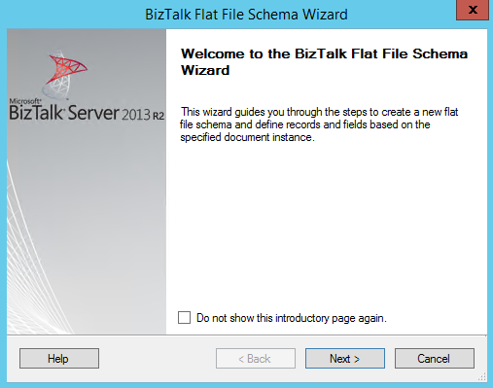
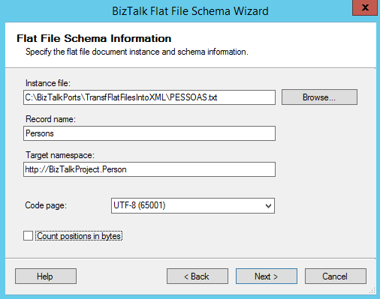
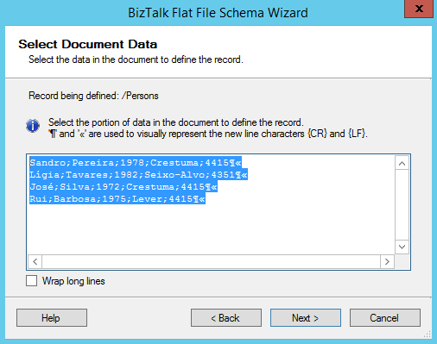
Using the Flat File Schema Wizard
Flat File Schema Wizard:
Graphical tool for defining flat file schemas
Can define schemas for delimited or positional flat files

Slide 14
Basic Flat Files Annotations

Slide 15
suppress_empty_nodes="true|false"
Removes empty nodes from the XML stream. This can be used to eliminate fields that are empty after being parsed
Field1-Field2
Field1-
<Root>
<MyRecord MyField1="Field1" MyField2="Field2" />
<MyRecord MyField1="Field1" Field2="" />
</Root>
<Root>
<MyRecord MyField1="Field1" Field2="Field2" />
<MyRecord MyField1="Field1" />
</Root>

Slide 16
generate_empty_nodes="true|false“
Generate empty nodes for records that exist in the XML instance data
<Root>
<MyRecord MyField1="Field1" Field2="Field2" />
<MyRecord MyField2="Field2" />
</Root>
Field1 Field2
Field2
Field1 Field2
Field2

Slide 17
allow_early_termination="true|false"
Used to allow the right-most positional field to be treated as a delimited field (i.e. can be shorter or longer than specified by the pos_length setting).
AAABBBCCC(CR+LF)
AAABBBCCC(CR+LF)
AAABBBCCC(CR+LF)
OK
AAABBBCCC(CR+LF)
AAABBBCC(CR+LF)
NOK

Slide 18
How Flat Files are processed

Slide 19

BizTalk Server 2013 R2 Runtime Architecture
XML EDI or Flat File
XML EDI or Flat File
Receive Port
Orchestration
Send Port
Receive Adapter
Receive Location
Send Adapter
Receive Pipeline
Send Pipeline
Mapping
Mapping
FROM: Contoso (Flat file format)
TO: NWTraders (Flat file format)
TO: Fabrikam (XML format)
MessageBox
FROM: Fabrikam (XML format)

Slide 20



What Is a Pipeline?
Use pipelines to:
Normalize data from various formats to XML
Translate data from XML to various formats
Assemble and disassemble documents
Decode and encode documents
Decrypt and encrypt documents
Assign and verify digital signatures
Orchestration
Receive Pipeline
Send Pipeline
Send Pipeline Components
Receive Pipeline Components
MessageBox Database

Slide 21
Pipeline Scenarios
Decode
Decode
Use to decode or decrypt messages
Use when secure document exchange is required
BizTalk includes a MIME/SMIME Decoder
!
Drop Here!
Disassemble
Disassemble
Use to parse or disassemble components
Use to probe messages and verify context properties
BizTalk Server includes an XML, flat file, and a BTF disassembler
Drop Here!
!
Validate
Validate
✓
Use to validate the format of an XML message
Use to compare a message to a known schema
!
Drop Here!
Resolve Party
Resolve Party
✓
Use to verify the sending party for a received message
Use with public certificates to validate sender
!
Drop Here!

Slide 22
Send Pipeline Stages
Pre-assemble
Pre-Assemble
Use to process a message before it is sent
Use for custom components only
Drop Here!
!
Assemble
Assemble
Use to assemble or serialize a message
Use to convert a message from XML to native format
Drop Here!
!
Encode
Encode
To encode or encrypt messages
Use when secure document exchange is required
BizTalk includes a MIME/SMIME decoder
Drop Here!
!

Slide 23

ANY
QUESTIONS
?

Slide 24


Slide 25
Thanks
sandro.pereira@devscope.net
linkedin.com/in/sandropereira
@sandro_asp
sandroaspbiztalkblog.wordpress.com
+351 223 751 350
www.devscope.net

